Slide 1
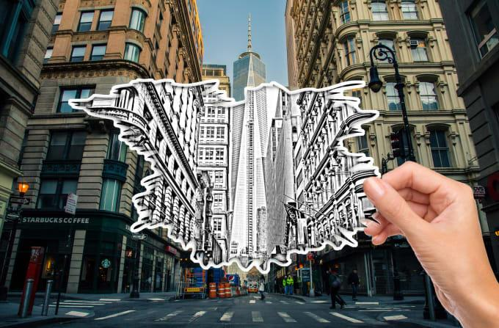
Project Title
Image Colorization
Team Name
Game Of Vision
Team members
Vinay Kumar Tadepalli (2018101048)
Samartha S M (2018101094)
Umesh Chandra Pola (2018101103)
Santhosh Reddy Mylaram (2018101030)
Mentor TA
Pulkit Gera
Repo URL
https://github.com/Computer-Vision-IIITH-2021/project-game-of-vision

Slide 2
TABLE OF CONTENTS
01
OBJECTIVE
02
PROCEDURE
03
METHOD OVERVIEW
04
TIMELINE
05
GOALS

Slide 3

Objective
Image colorization is an age old problem in Computer Vision domain
It is a computerized technique to add color and style to an image which is originally black and white (grayscale) image.
It can be used to restore colors from old black and white photos or movies.

Slide 4
Procedure
The paper divides coloring the image into different sections which are summarized in the following slides as follows
Extracting Low-Level Features
Extracting Global Features
Extracting Mid-Level Features
Fusing Mid-Level and Global Features
Colouring the Image

Slide 5

Method Overview...
We first send the input gray-scaled image through a convolutional network to obtain low-level features of the image.
Then we use this as an input to another convolutional network to obtain mid-level features.
Also, we use the low-level features to obtain global features by passing the low-level features through a series of convolutional and linear fully-connected layers.
We then fuse the global features with the mid-level features and send it to the colorization network.
The colorization network consists of a set of colvolutional and upsampling layers which produces a chromiance output which can be merged with the given grayscale image to produce the final colored image.

Slide 6
Method Overview...
The global features contains the high level information about the scene like what time of the day the image has been taken, is it an indoor image or an outdoor image
The local features represent the local texture or object at a given location
We can use a style transfer technique where the global features of an image can be used to color another image to get a different scene coloring of the same image
Due to the constraints on the input size fully connected layer in the global feature network, the input image should be scaled to 224X224 before computing the low-level features

Slide 7
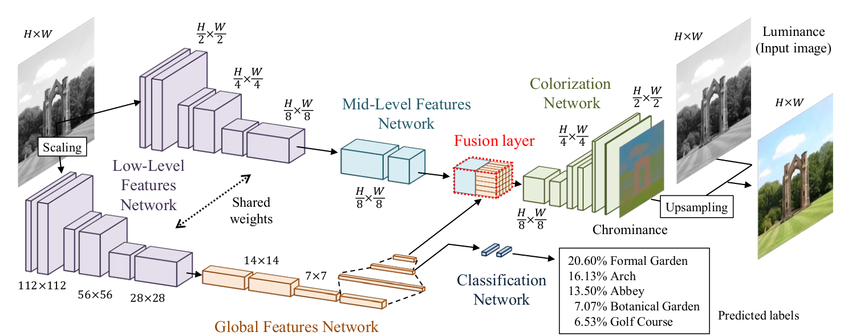
Convolutional Neural Network Model

Slide 8
Project Timeline
Global and mid-level features
Training the CNN model
Feb 15
Feb 28
Mar 15
Mar 31
Apr 15
Apr 30
Understand the paper and implement low level features
Implementing fusion layer and colorization layer
Testing the trained model on grayscale images

Slide 9
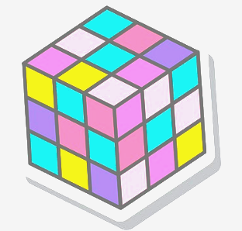
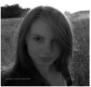
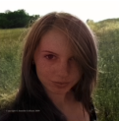
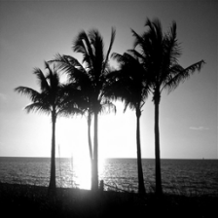
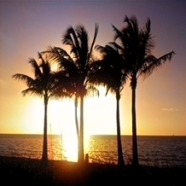
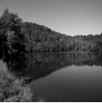
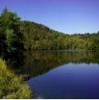
Goals
A user-intervention-free approach to colorize grayscale images.
A novel end-to-end network that jointly learns global and local features for an image
A learning approach that exploits classification labels to increase performance.
A style transfer technique based on exploiting the global features.
In-depth evaluation of our model with user study and many diverse examples, including hundred-year-old black-and-white photographs.

Slide 10
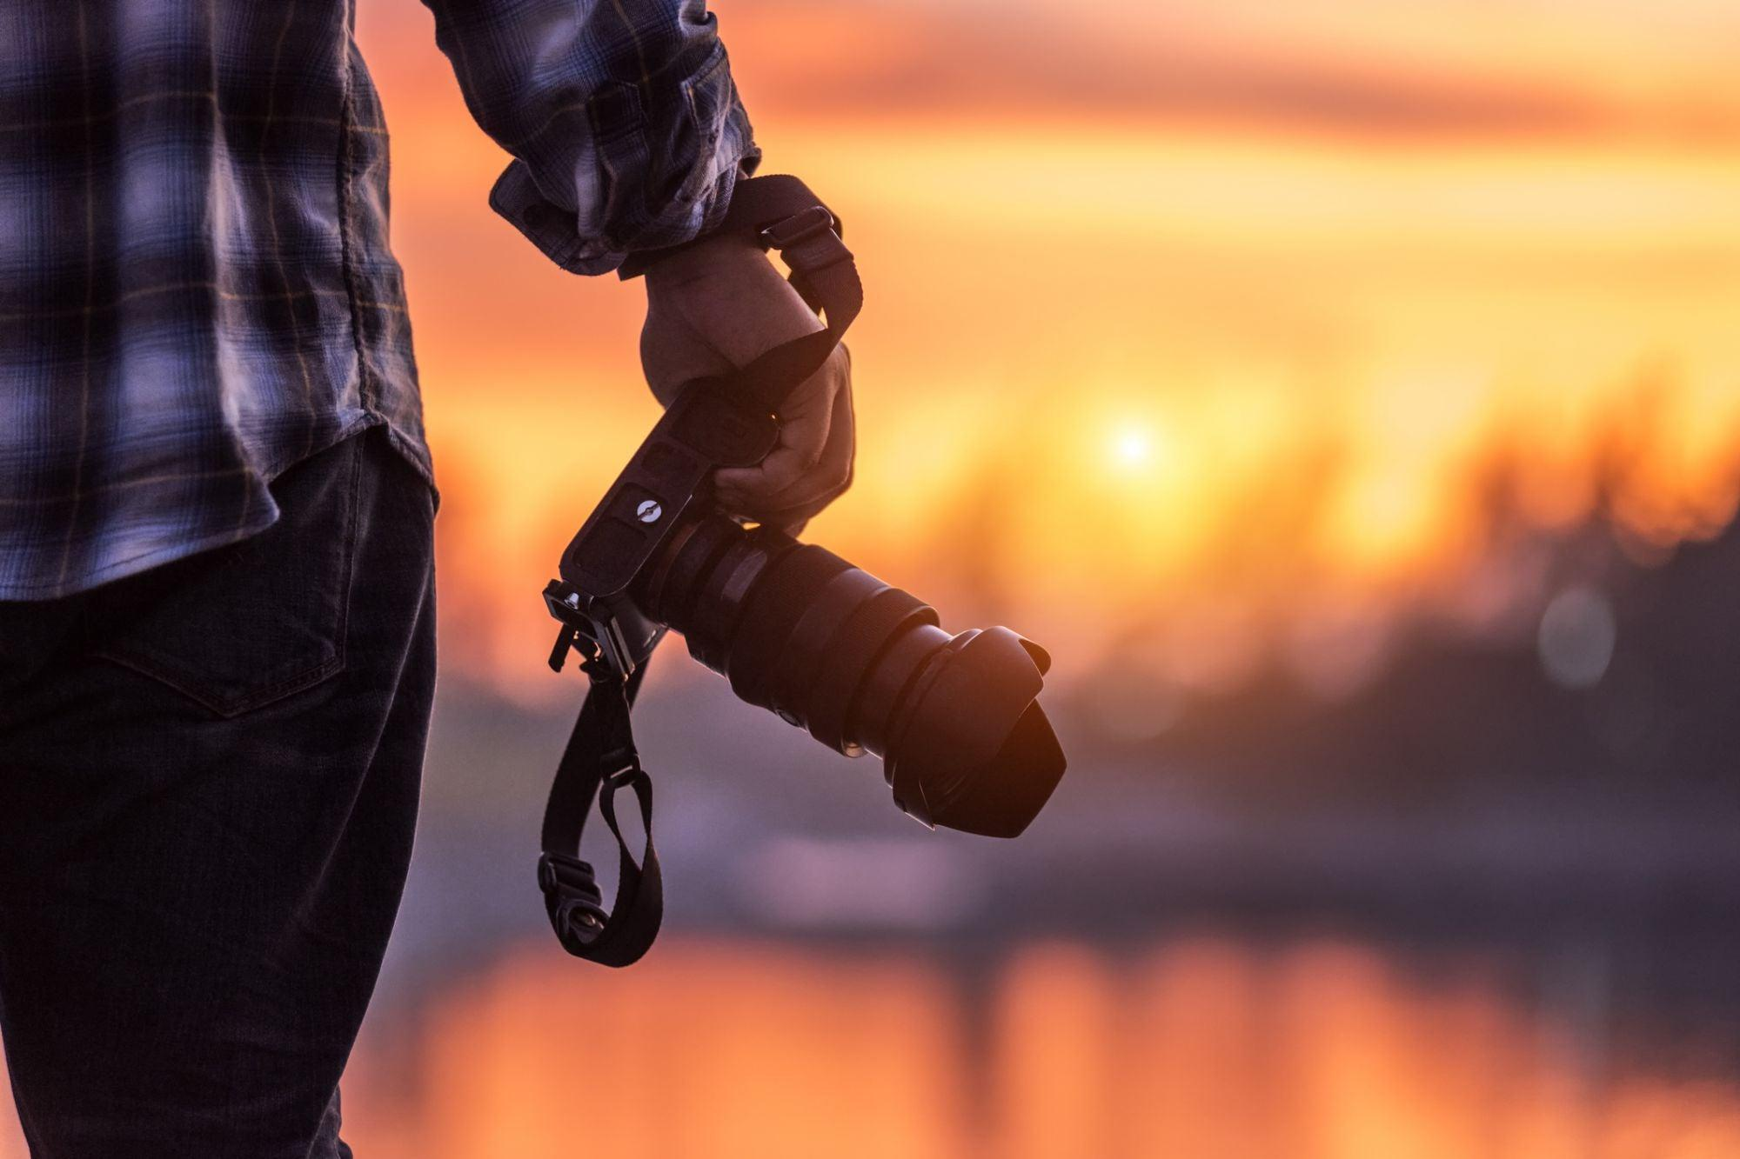
A Picture is worth a Thousand words

